Slide 1
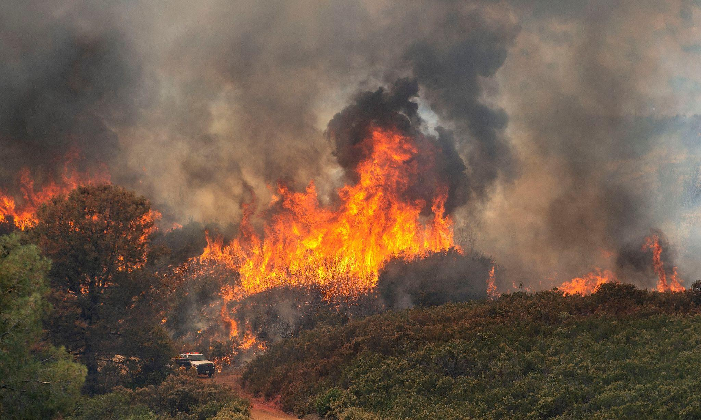
California Wildfire Incidents Analysis
(2013–2020)
Nia Richard | Denis Kalala | Renz Carl Supnet | Jay Boon | Esteban Ortega
photo Calfire

Slide 2
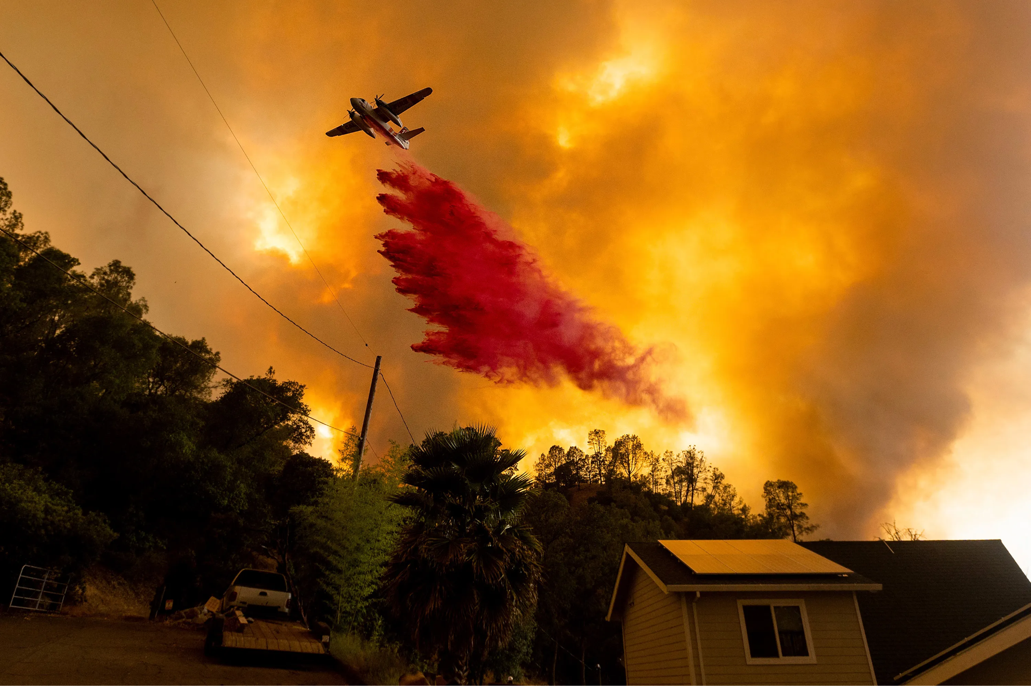
California Wildfire Incidents Analysis (2013–2020)
Understand the trends, causes, and impacts of wildfires in California between 2013 and 2020.

Slide 3
California Wildfire Incidents Analysis (2013–2020)
Understand the trends, causes, and impacts of wildfires in California between 2013 and 2020.

Slide 4
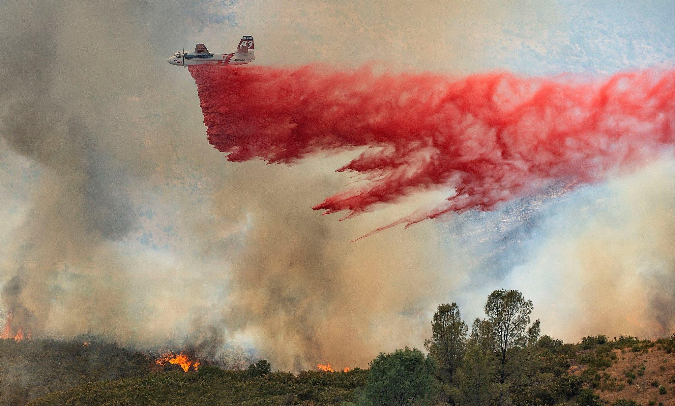
The Dataset we used:
Kaggle dataset - California Wildfire Incidents (2013-2020) (Dataset Link) Data handling
Null values are changed to zero or a blank value under logical assumptions.
Proper Data types.
Nia Richard, Denis Kalala, Renz Carl Supnet, Jay Boon, Esteban Ortega

Slide 5
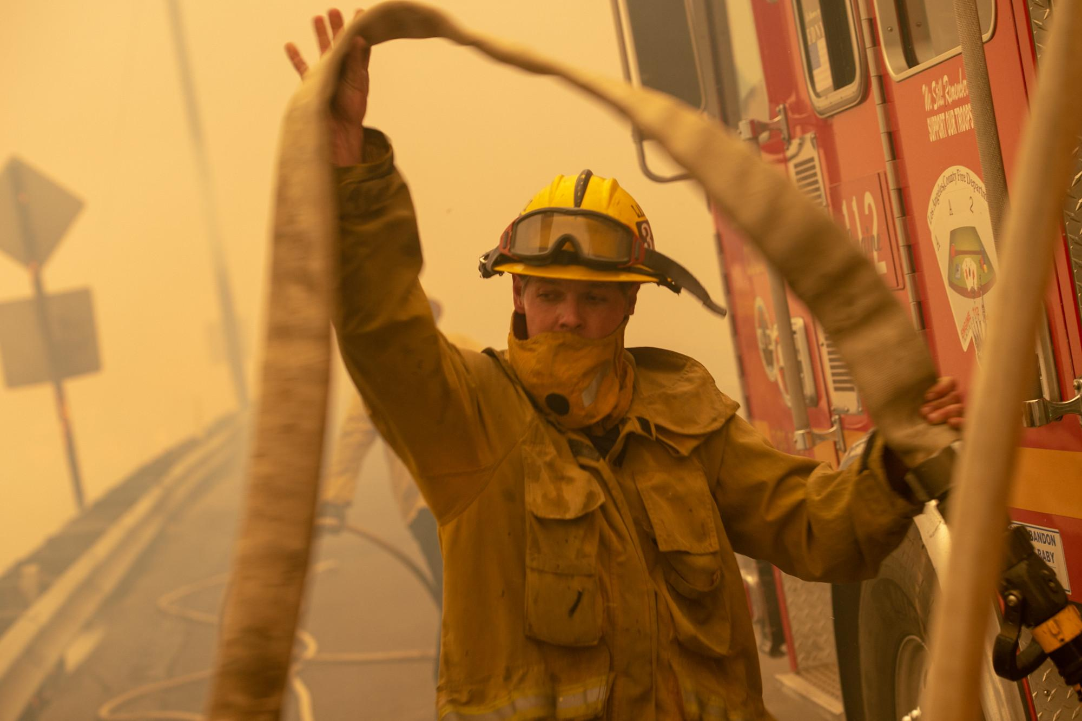
Project Objective: Analyze patterns, trends, and insights in wildfire occurrences across California.
Questions:
📌 Nia: What are the geographic patterns of wildfire occurrences (latitude/longitude mapping)?
📌 Renz How does the number of fire incidents vary by month?
📌 Jay What is the optimum firefighter-to-acre ratio for effective wildfire suppression?
📌 Dennis How the injuries and the deaths correlate overtime?
📌 Esteban How many personnel, air tankers, and other firefighting resources are used on average per wildfire?

Slide 6
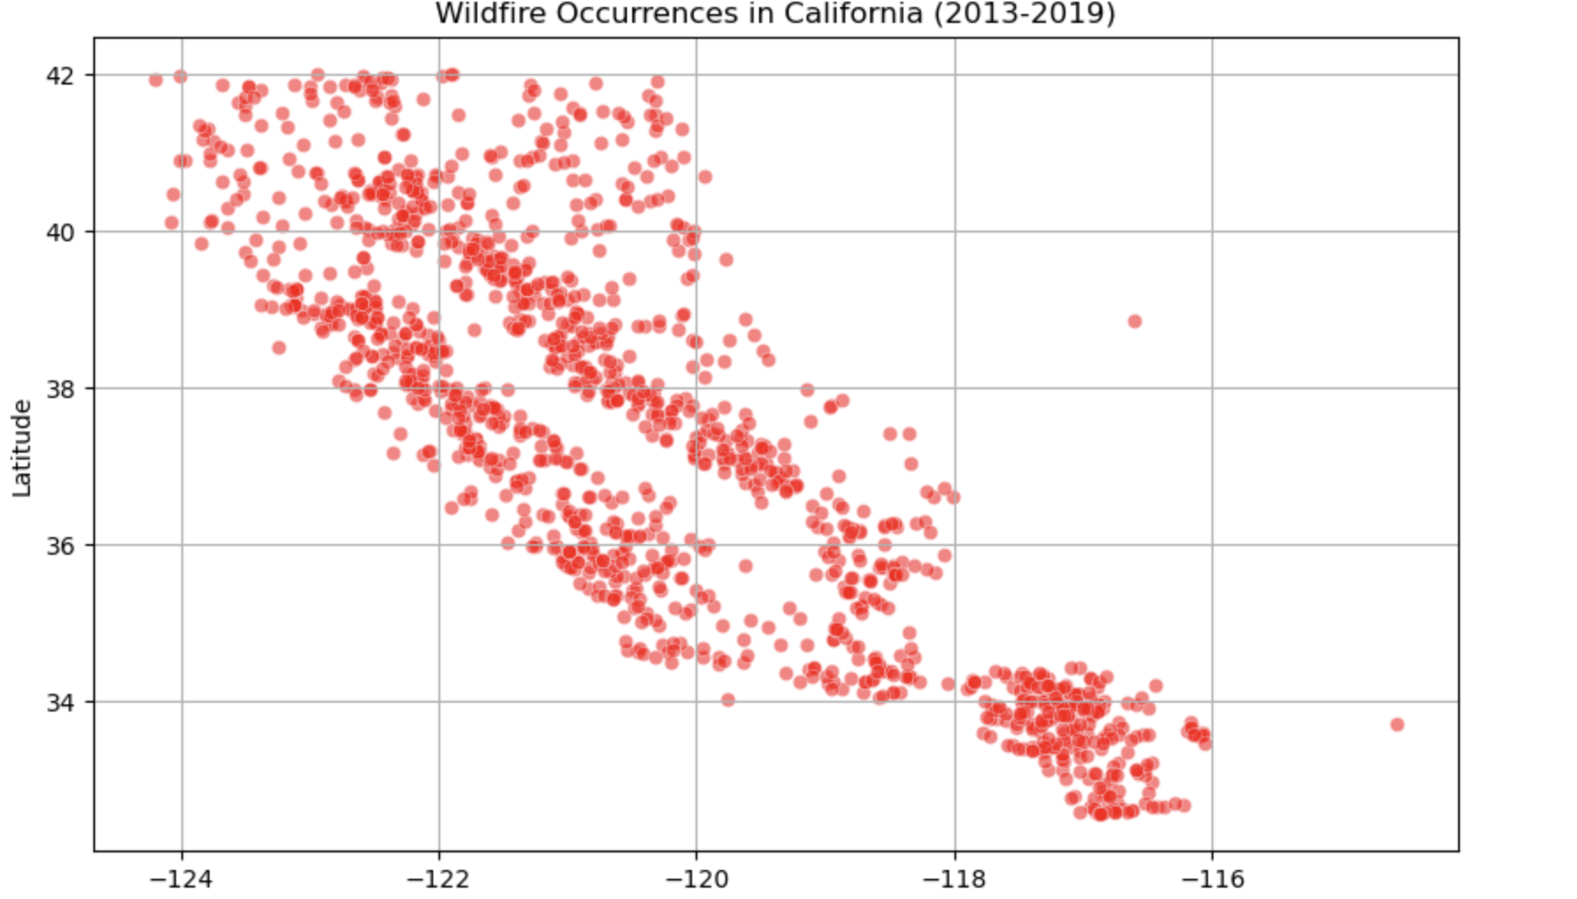
Nia: Geographic Patterns of Wildfire Occurrences (Latitude/Longitude Mapping)
Visual: Scatter plot of the wildfire incidents over California based on latitude and longitude.
Description: This will show where wildfires are most frequent geographically, giving insights into regions with higher wildfire risks.

Slide 7
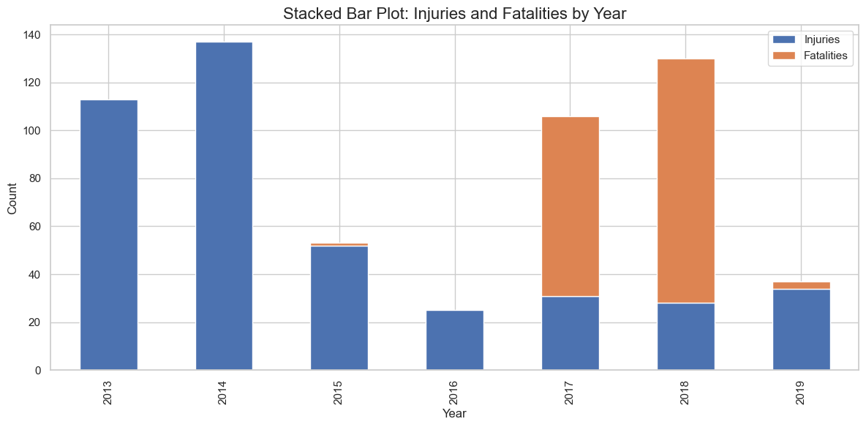
📌 Denis: How Do Injuries and Deaths Correlate Over Time?
Visual: Stacked Bar graph showing the number of injuries and deaths per year, overlaid on a graph showing the area burned or severity of fires.
Description: This will help explore whether the number of injuries and deaths increases with larger fires or if there have been improvements in safety and firefighting techniques.

Slide 8
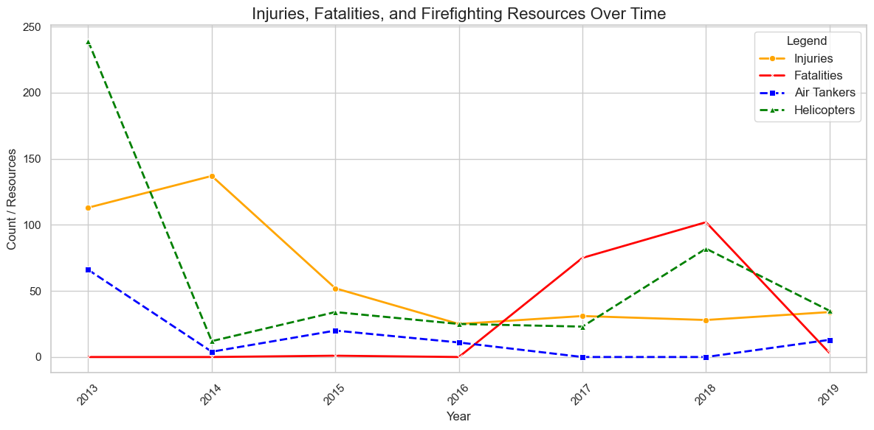
📌 Denis: How Do Injuries and Deaths Correlate Over Time with regards to resources used over time?
Visual: line graph showing the number of injuries and deaths per year, with comparison to the resources (mainly being air tanks and helicopters) used or available over the past years.
Description: This will help explore whether the number of injuries and deaths increased with the lack of expensive resources such as the air tanks and the helicopters which use up alot of fuel consumption.
Conclusion: Through this we can see the less resources used results in lots more casualties and as opposed to it just being minor injuries.

Slide 9
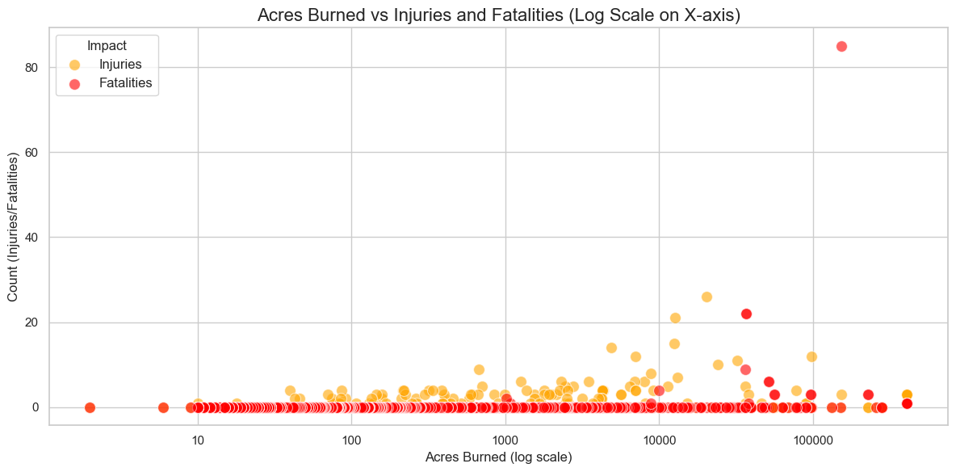
Denis: How Do Injuries and Deaths Correlate with regards to the spread of the flames?
Visual: Scatter plot using the log scale the graph showing the number of injuries and deaths per year across the acres burned, overlaid on a graph showing the area burned or severity of fires.
Description: This will help explore whether the number of injuries and deaths increases with larger fires.
Conclusion: The biggest take away from this graph is that the size of the fire through acres burned does not affect the casualties and injuries as much as we think it would.

Slide 10
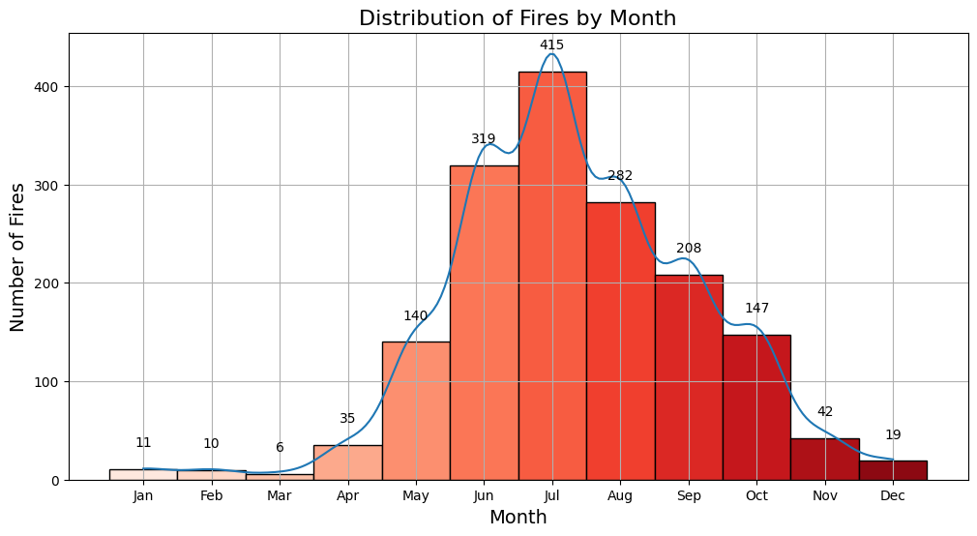
📌 Renz: How Does the Number of Fire Incidents Vary by Month?
Visual: A bar chart or line graph showing the number of fire incidents by month for each year.
Description: This visualization will highlight the monthly pattern of fire incidents, showing which months have the highest frequency of wildfires.

Slide 11
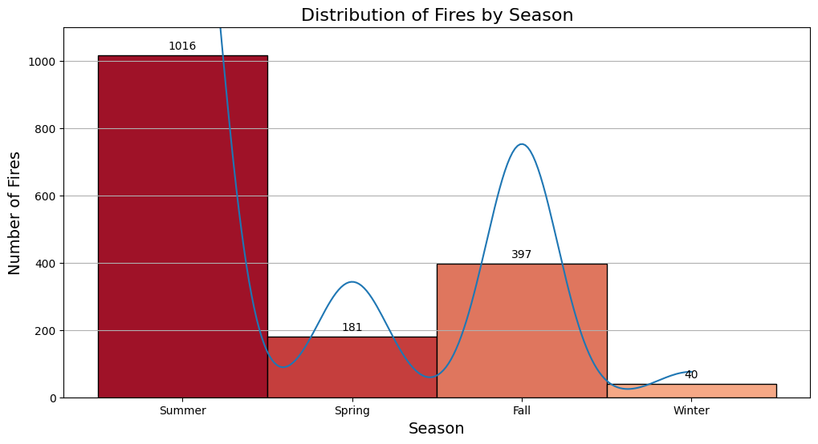
📌 Renz: How Does the Number of Fire Incidents Vary by Season?
Visual: A bar chart or line graph showing the number of fire incidents by month for each year.
Description: This visualization will highlight the seasonal pattern of fire incidents.
Kruskal-Wallis H-statistic: 1134.8564, P-value: 0.0000

Slide 12
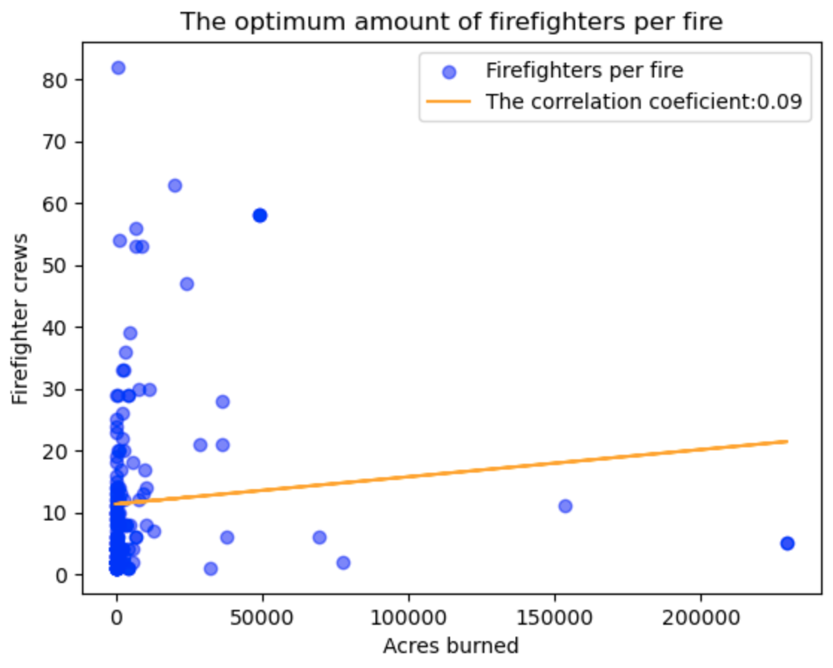
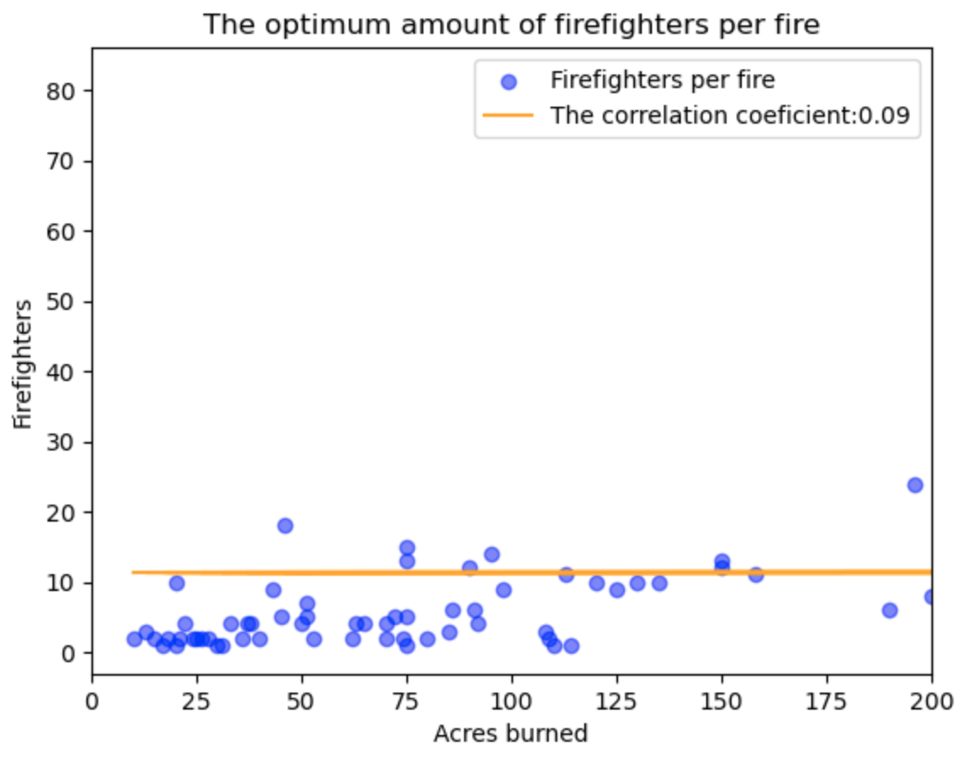
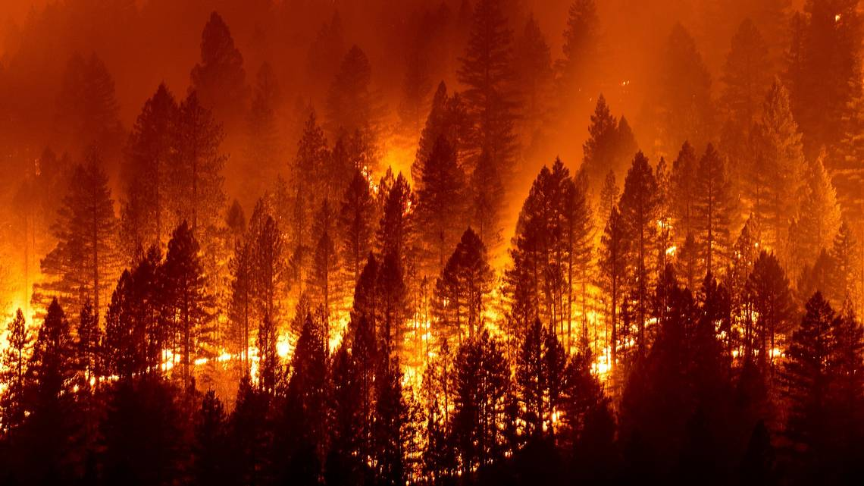
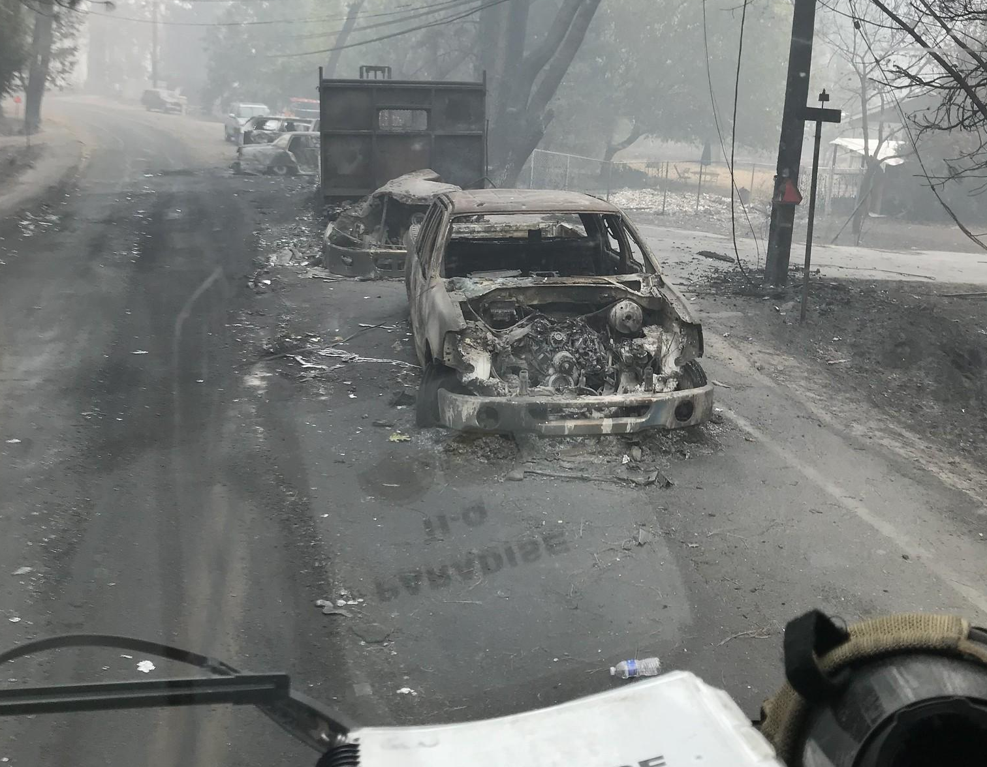
📌 Jay: What is the optimum firefighter-to-acre ratio for effective wildfire suppression?
Conclusion: It’s not about the size, it’s the location.

Slide 13
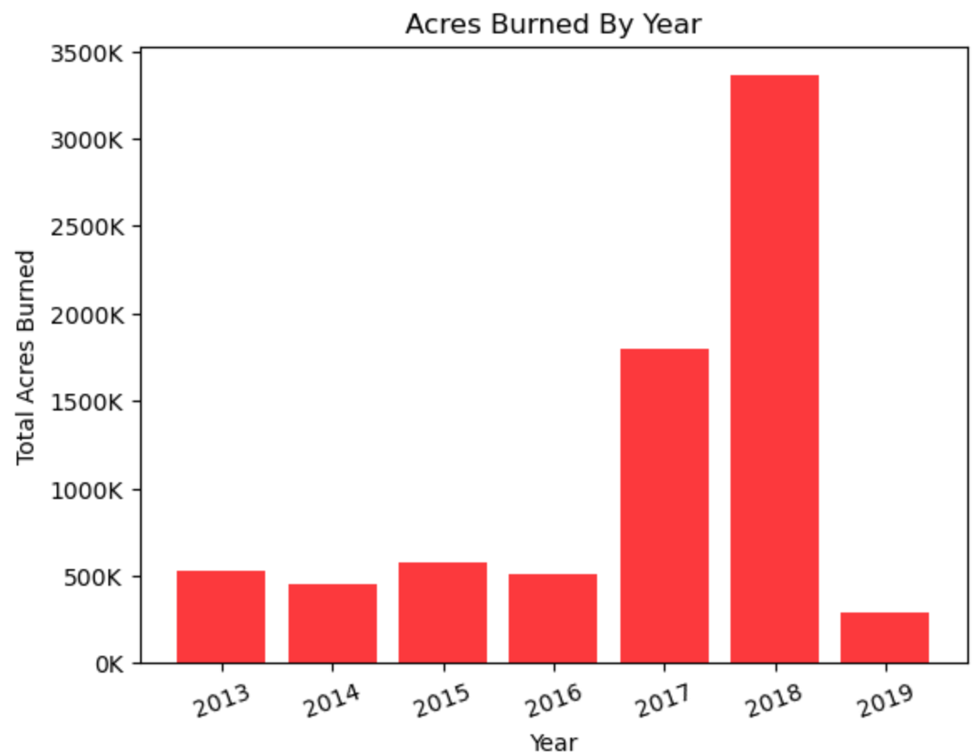
📌 Jay: Are the fires increasing over time?
Unusually large fires:
Thomas Fire (2017) 281,893 acres
Nuns Fire (2017) – 56,556 acres
Mendocino Complex Fire (2018) 459,123 acres
Ranch Fire(2018) 410,203 acres
Carr Fire (2018) 229,651 acres
Camp Fire(2018) 153,336 acres
Woolsey Fire 2018) 96,949 acres

Slide 14
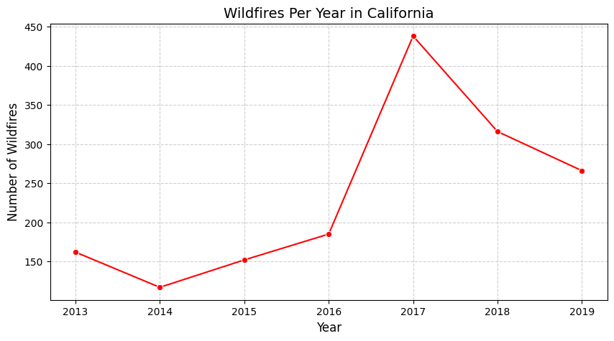
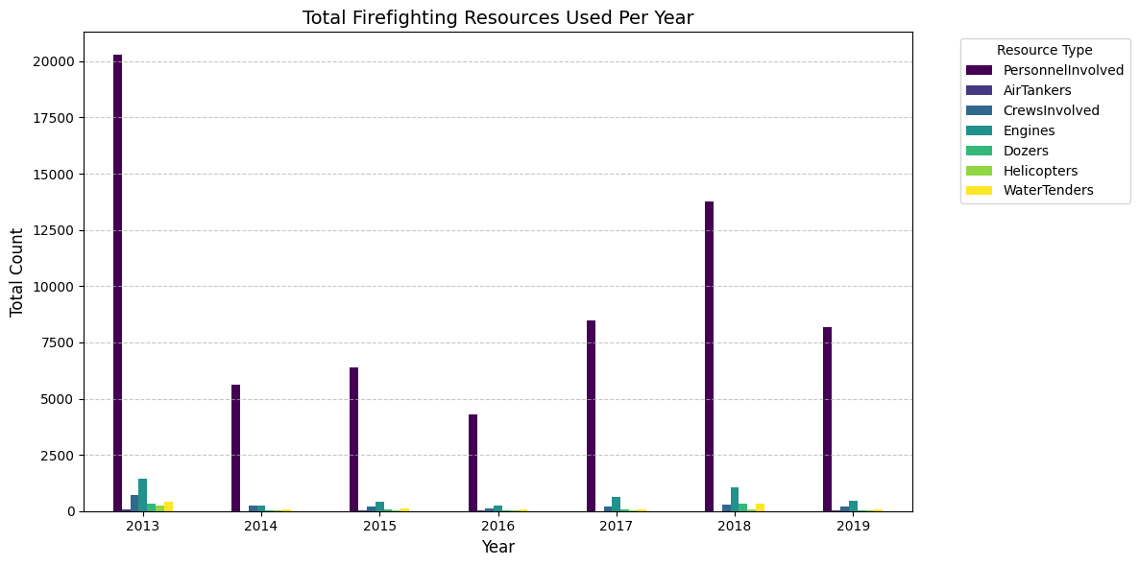
📌 Esteban: Wildfires Per Year & Resources Used Per Year

Slide 15
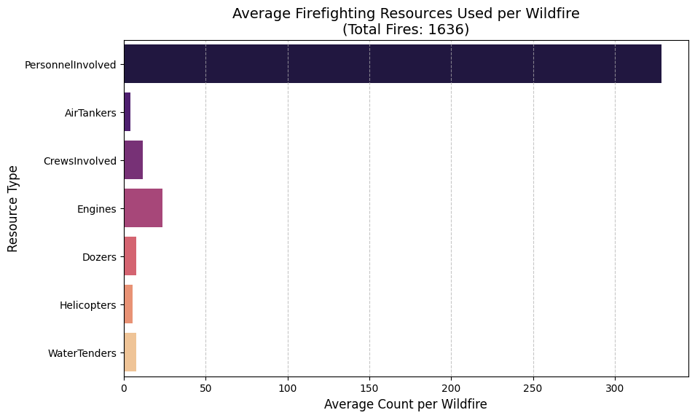
📌 Esteban: Average Personnel, Air Tankers, and Other Firefighting Resources Used Per Wildfire

Slide 16
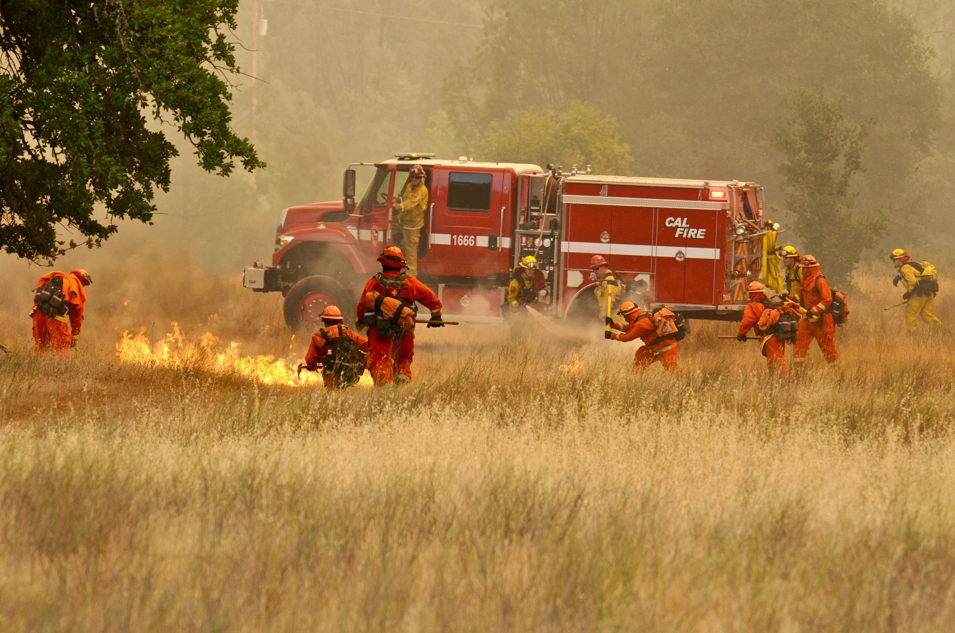
Questions?

